Slide 2
Local vehicle Detection
Submitted To:
Mr Faisal Muhammad Shah | Md. Tanvir Rouf Shawon
Associate Professor (AUST) | Lecturer(AUST)
Presented by:
Sabbir Ahmed Maishameem Meherin Muhu Lamia Anjum
170104011 170104017 170104023

Slide 3
Motivation
Remove the need of human labor for simple vision based tasks .
Monitoring and analyzing scenes of road traffic, with particular interest in monitoring highways and intersection.
Detect changes in traffic characteristics in a timely manner
Allowing authorities the ability to quickly respond to traffic situations.

Slide 4
Introduction
Humans can easily recognize vehicles in videos or images or to identify different types of cars. In computer algorithms and programs it is highly depend on the types of data. Object detection attracted the attention in research industry lately. Researchers are trying to explore the topic to reach to an accepted accuracy level. There are different techniques and methods for vehicle detection and classification.Here we use HOG for feature extraction and SVM for local vehicle detection.

Slide 5
Problem Statement
Some challenges like the weather or light are also plays important role on making the process easy or much hard.
At the same time we have different types and shapes of vehicles.
More than that the new challenge could be to identify moving objects in a video in real time where they are different in size and shape.

Slide 6
Data Acquisition
There are two different dataset where we experience our model for comparison:
Vehicle Dataset
Non-vehicle Dataset

Slide 7
Data Preprocessing
Real Life Video
Split frames from the video
Divide the frames into images
Resize the images
Crop the image for single vehicle

Slide 8
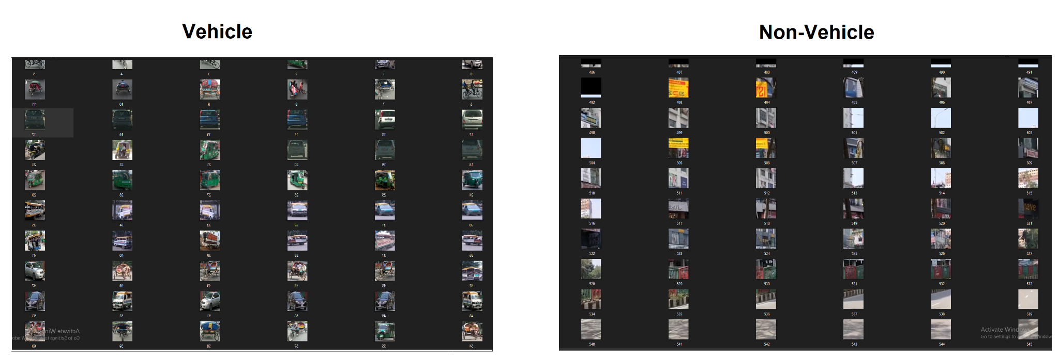
Final Dataset

Slide 9
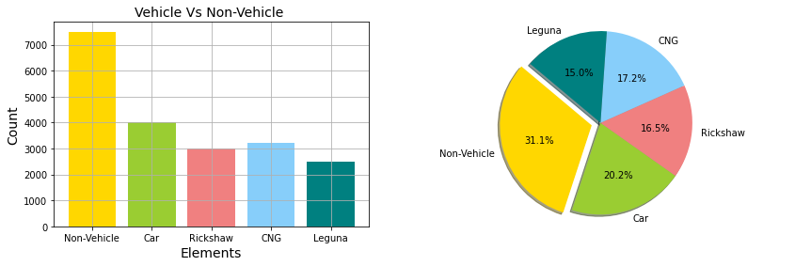
Approximate vehicle in Data set

Slide 10
Methodology
Real life Video
Data Acquisition
Data Preprocessing
Feature Extraction
Classification
Accuracy

Slide 11
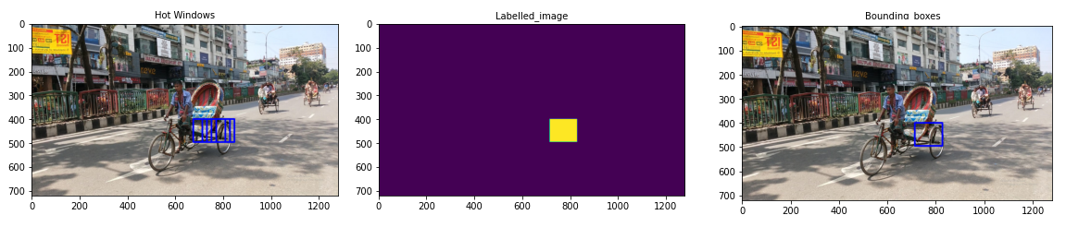
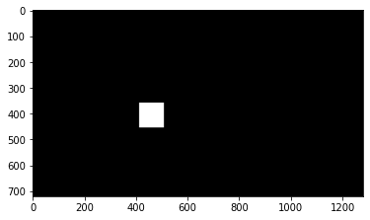
Result

Slide 12
Final Output

Slide 13
Future Work
Will enrich the dataset of all vehicles .
Will try to apply more models for detecting vehicles.
For analysis we can implement multiple model

Slide 14
Conclusion
The aim of this study was to find out the local vehicles from the real life experience. For this, we had to create our own dataset focusing mainly our most common four local vehicles : CNG, Leguna, Rickshaw ,Car. After extracting features using HOG & detecting with SVM gives accuracy of .9983.

Slide 15


